Slide 1
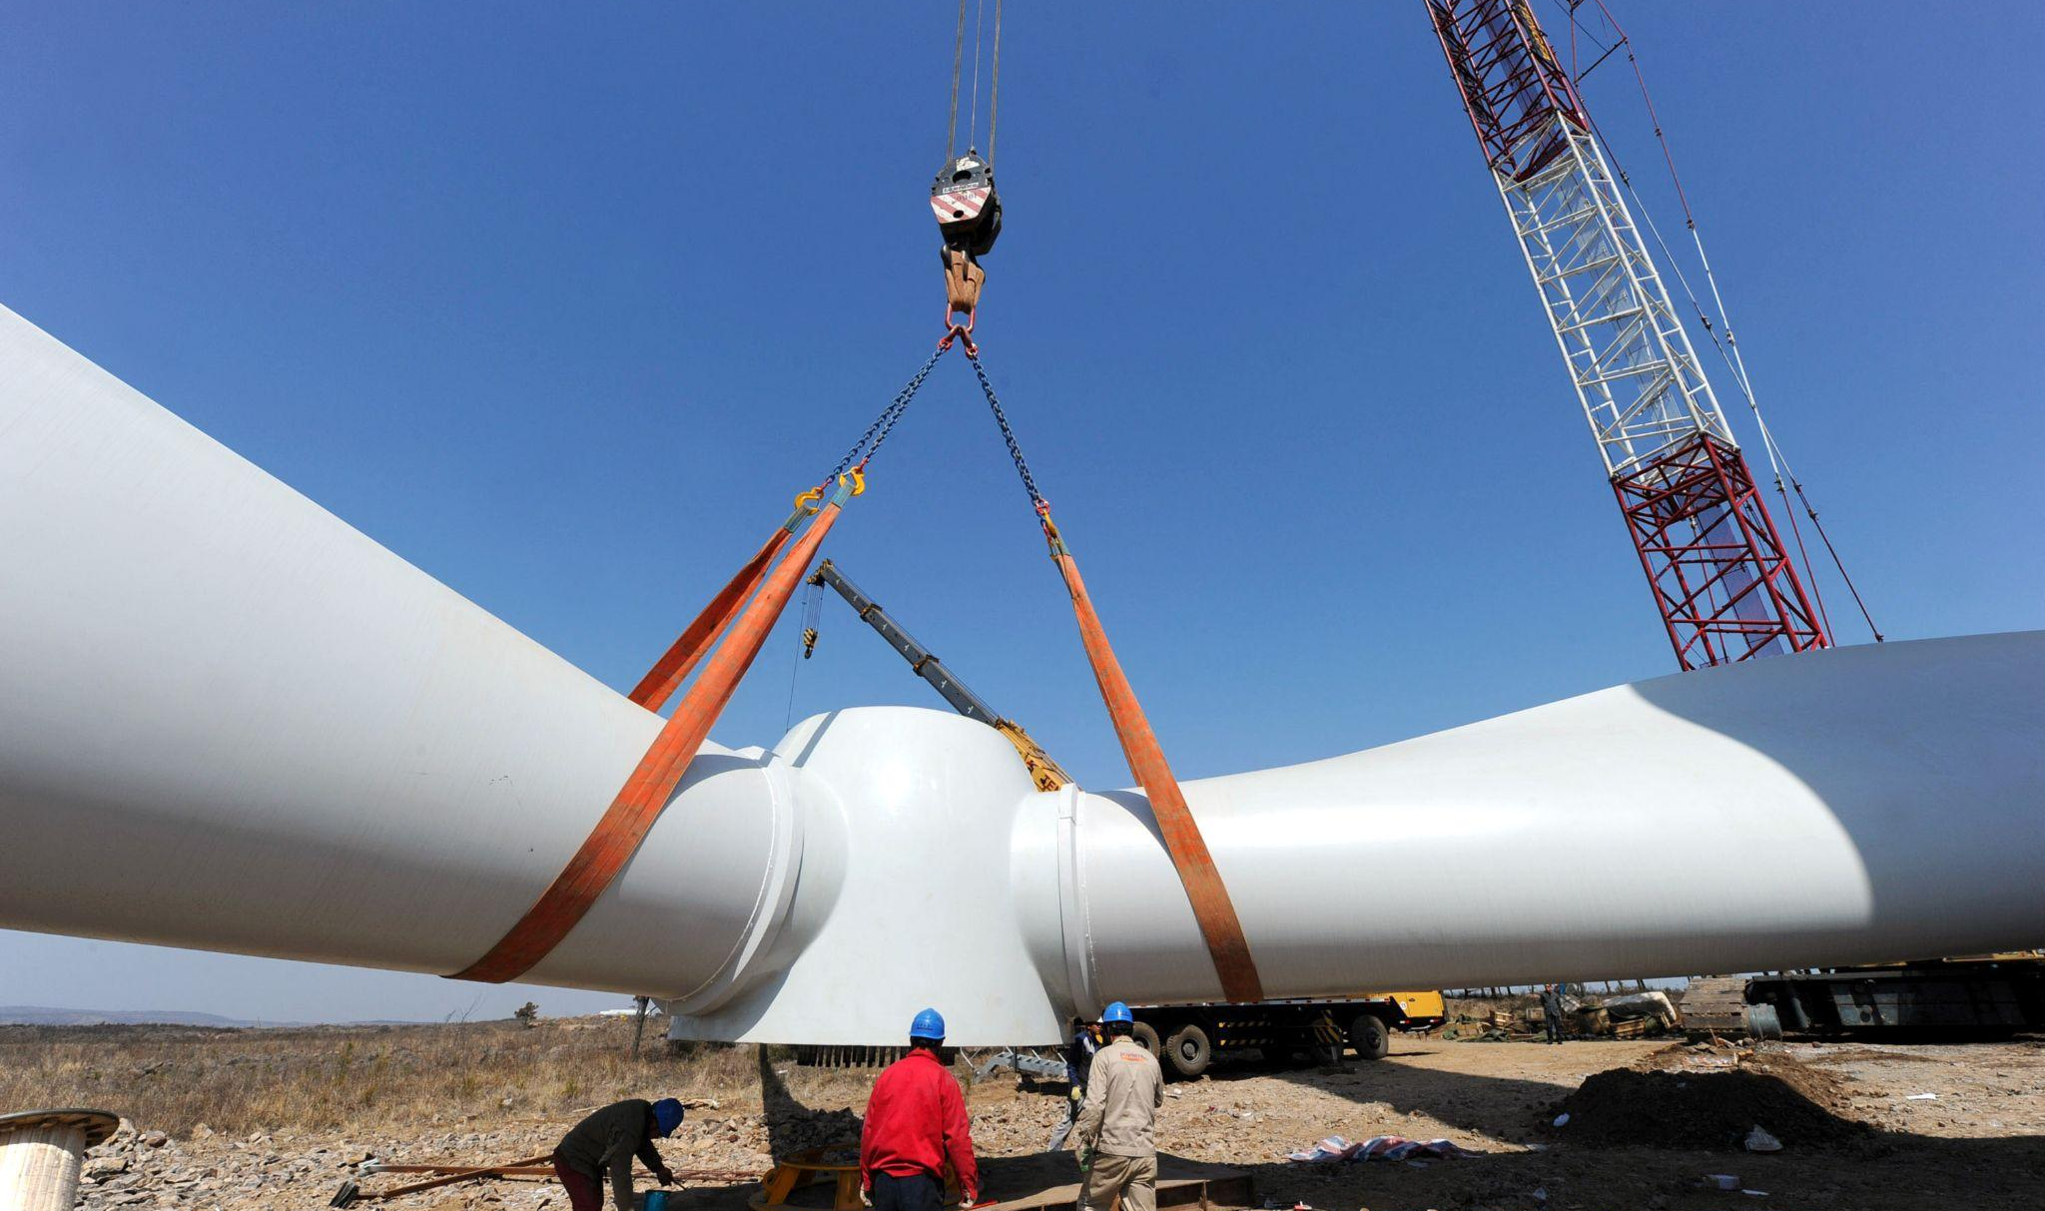
Massachusetts Climate Careers: Powering the Future
Climate Hero Spotlight:
Wind Turbine Technicians
Lesson 1. Understanding and Combating Climate Change
|
1

Slide 2
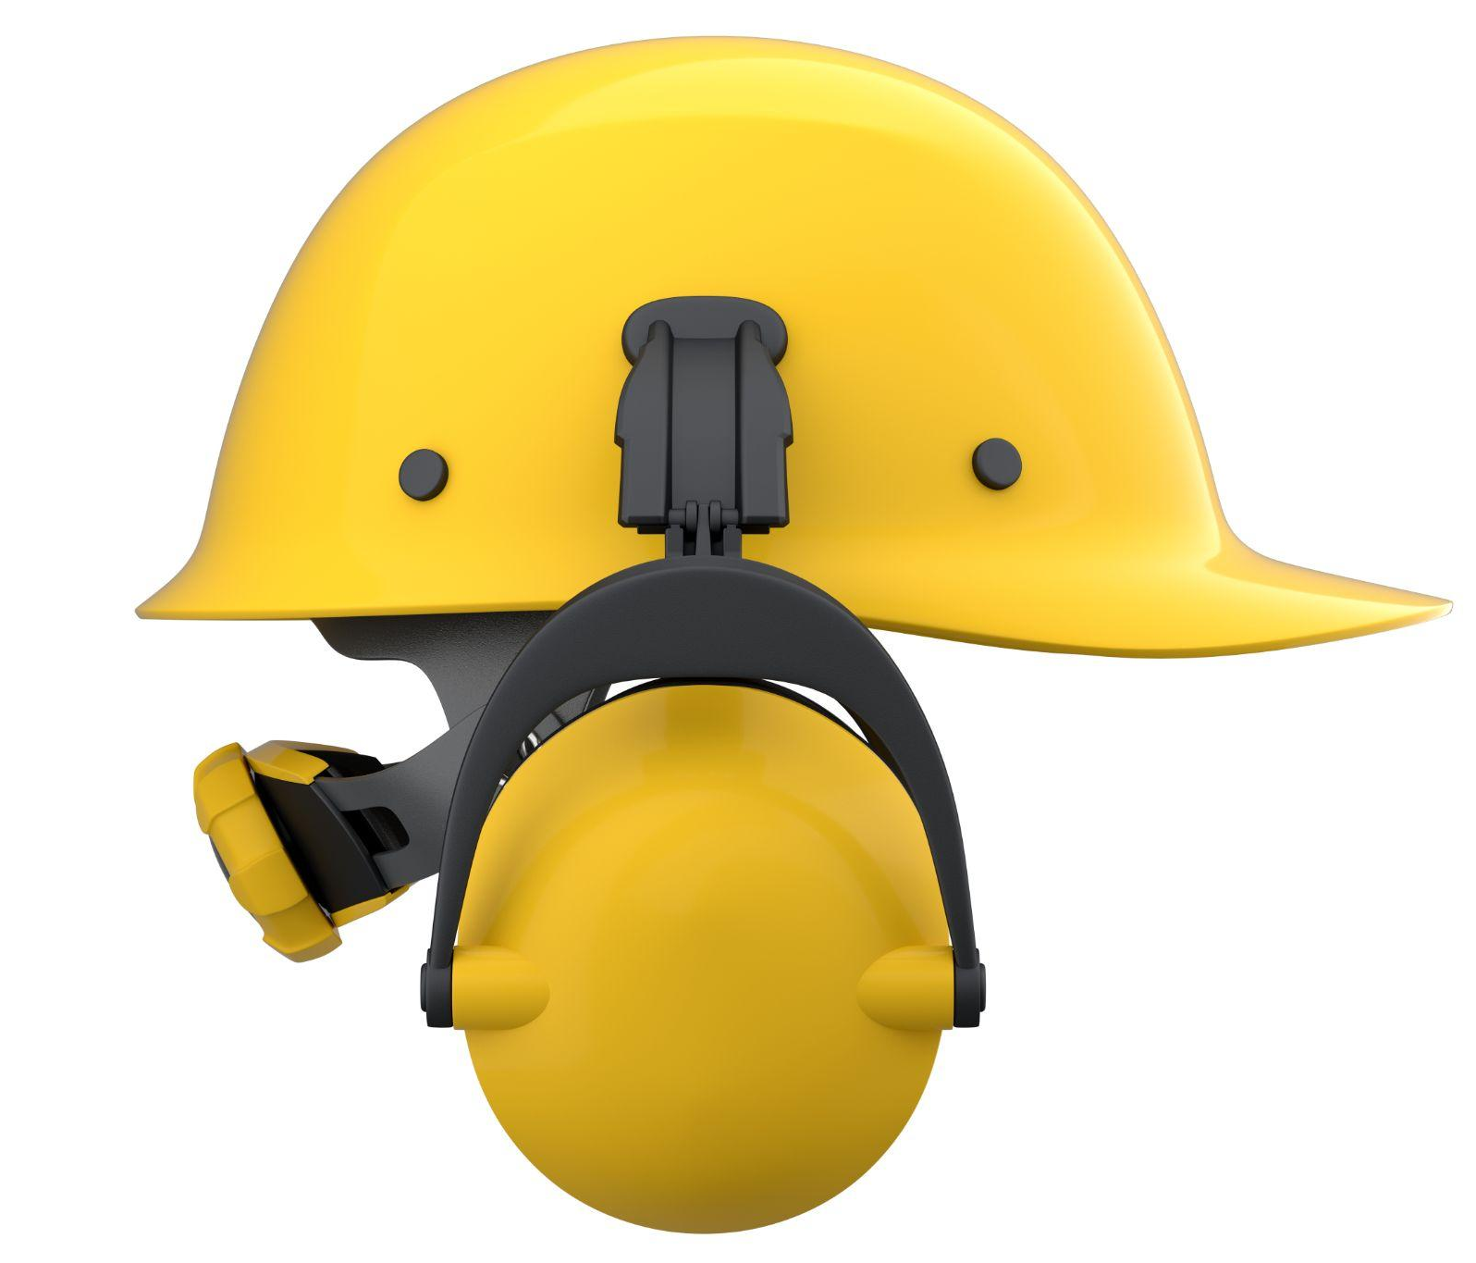
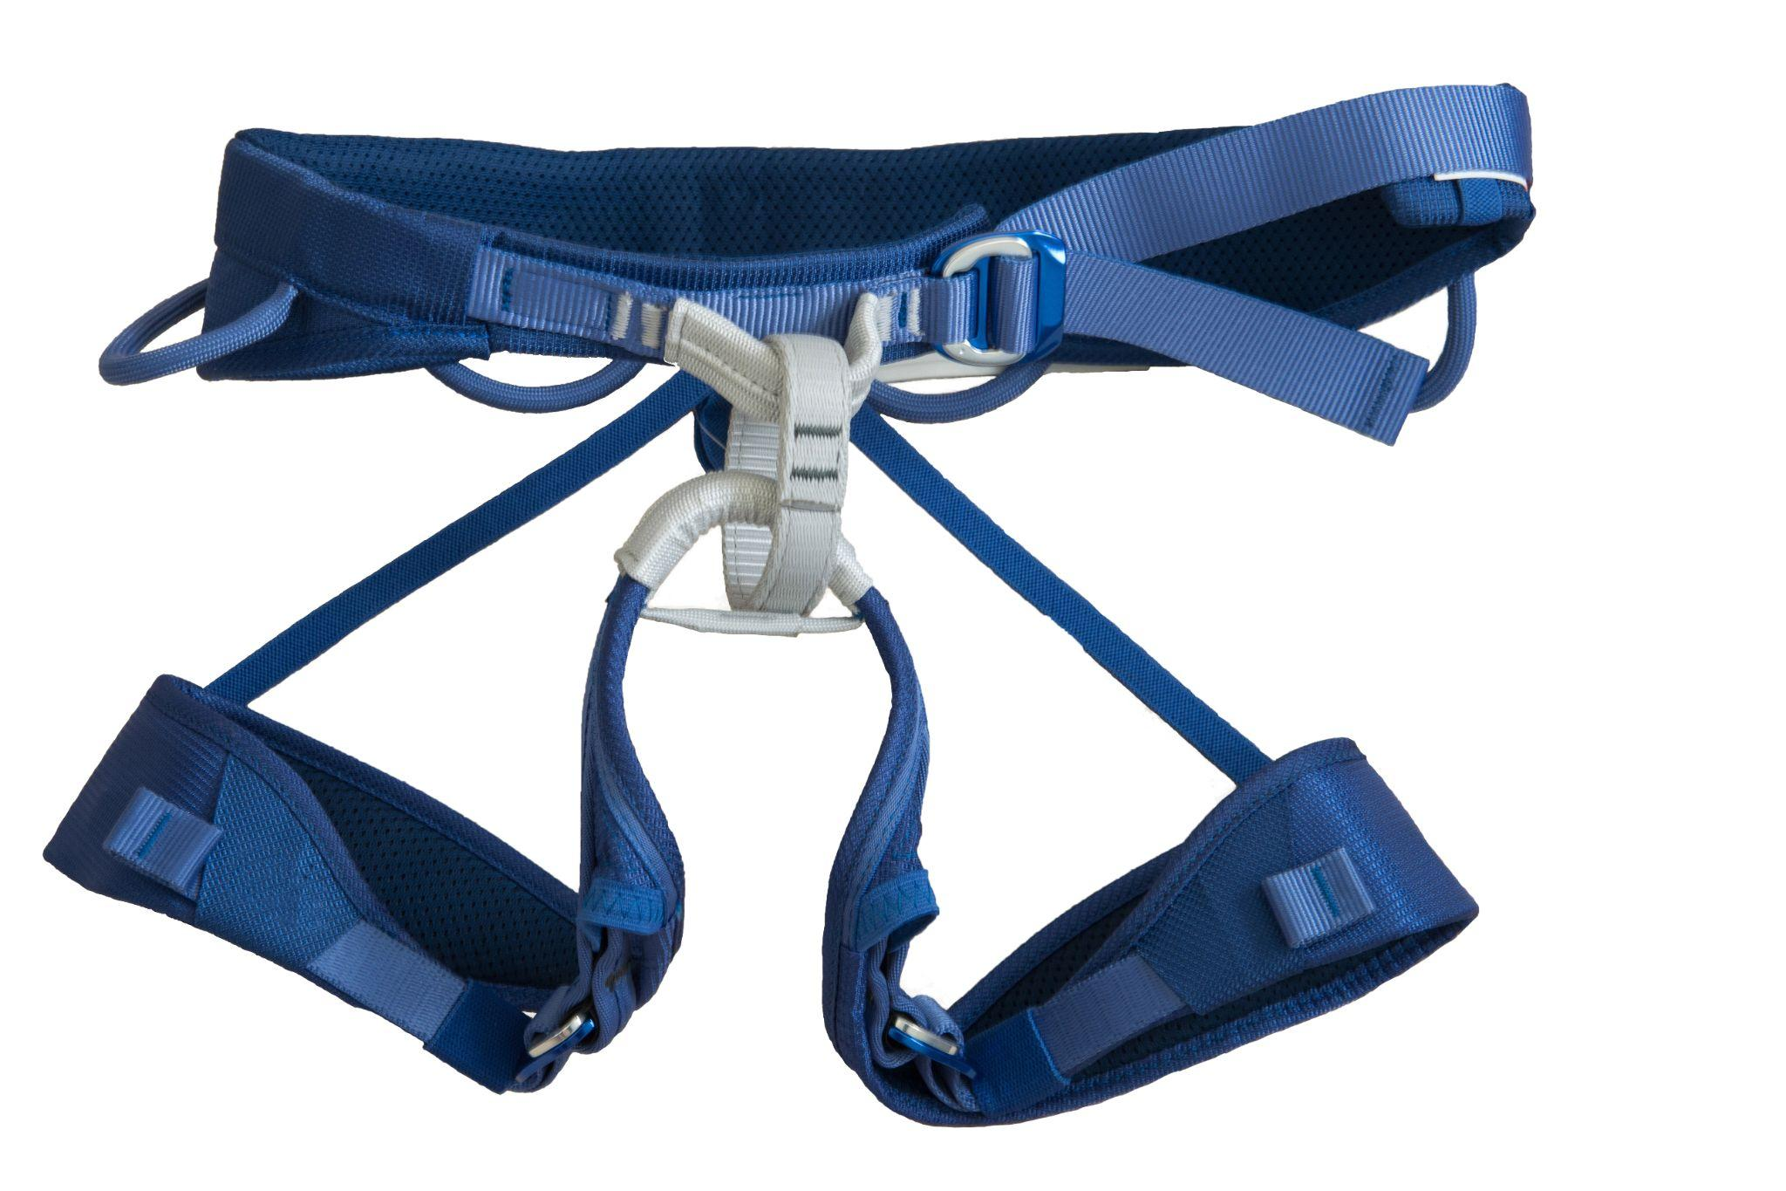
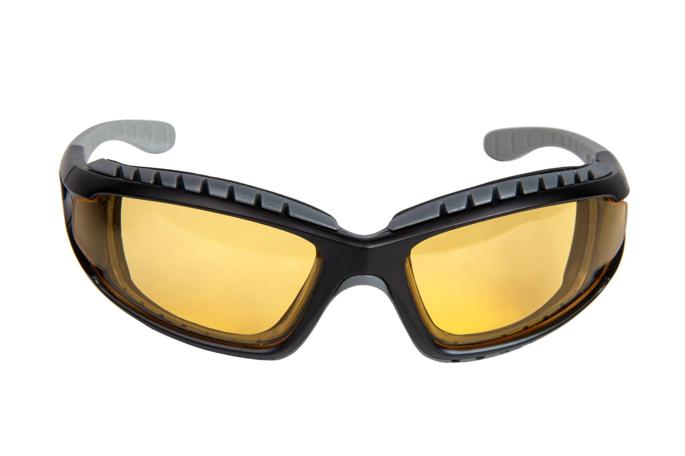
Opening Activity
Why would each of these items be necessary for keeping wind turbine technicians safe?
Lesson 16: Wind Turbine Technicians
Notes:
Activity objective: Introduce students to the personal protective equipment (PPE) used by wind turbine technicians and similar roles in clean energy sectors.
Background: Many clean energy workers work in environments with high heights, strong winds, and heavy machinery, where PPE is essential.
Instructions:
Ask students to get into pairs (or small groups if necessary).
Present the images on the screen.
With their partner, students should discuss each item shown and the risks against which the item protects in a real job setting.
Encourage them to start with wind turbine technicians, but students may consider any clean energy project discussed so far in class.
After two or three minutes, go through the objects individually. and invite students to share their ideas with the class:
Helmet (protection from head injuries, falling objects, accidental impacts).
Harness (fall prevention, used during climbs and repairs at height).
Goggles (eye protection from dust, debris, and strong winds).
Work gloves (hand protection from sharp objects, electrical components, and exposure to the elements).
Steel-toed boots (foot protection from heavy equipment, objects, and tools).
Ear protection (noise reduction, protecting hearing from loud machinery sounds and exposure to the elements).
PPE and safety protocols govern tasks such as how workers climb and manage tools and even how often they check the weather; these are critical to jobs like those of wind turbine techs.
Wind turbine techs face unique hazards, especially from heights and weather conditions. They’re exposed to strong winds and sometimes extreme temperatures.
Working safely allows techs to keep the turbines running correctly, contributing to climate goals—remember, the goal is to have a cleaner and healthier Massachusetts!

Slide 3
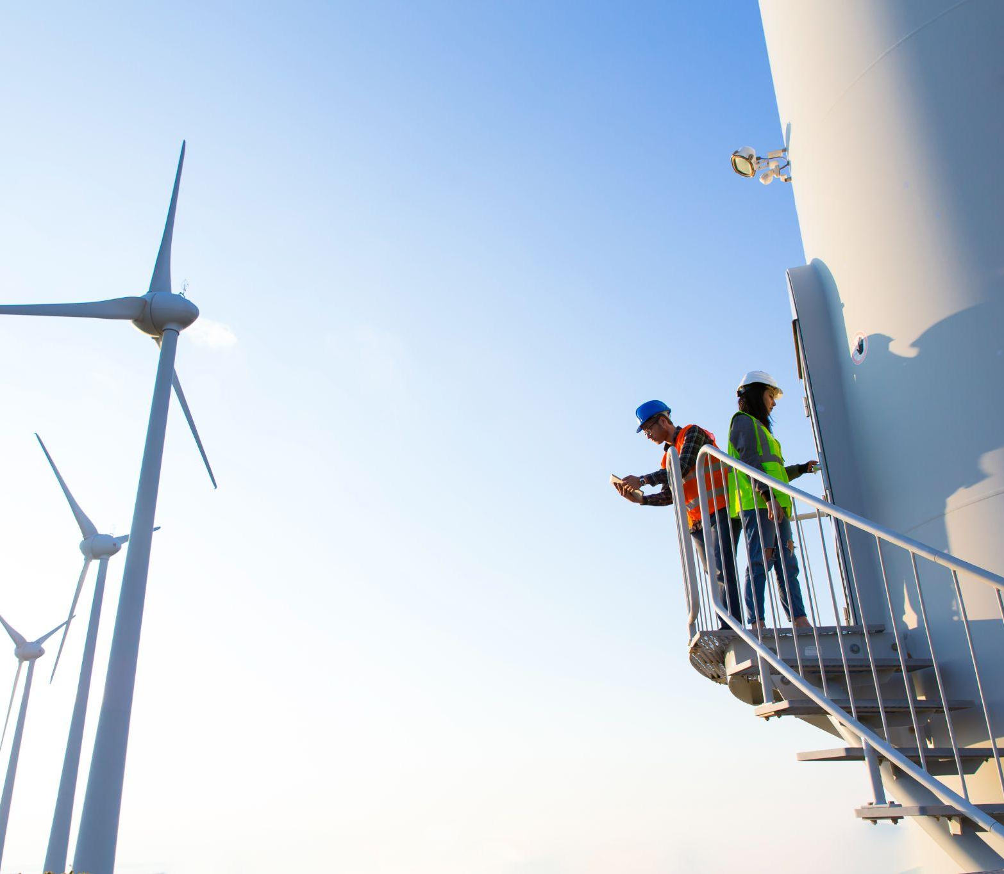
Today’s Agenda
The Big Question and My Climate Goals
Intro to Wind Turbine Technician Roles
Climate Watch and Discussion
Turbine Troubleshoot Challenge
Key Takeaways and Closing
Lesson 16: Wind Turbine Technicians

Slide 4
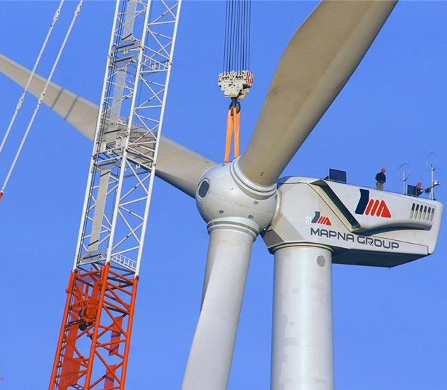
How are wind turbine technicians essential to the offshore wind industry and our energy goals in Massachusetts?
The Big Question
Lesson 16: Wind Turbine Technicians

Slide 5
When you finish this lesson, you’ll be able to:
Understand wind turbine technician roles and contributions to clean energy.
Recognize the link between climate goals and the need for wind turbine technicians.
Explore the skills, training, and pathways for wind turbine technician careers.
Connect personal interests to possible roles in wind turbine technology.
Lesson 16: Wind Turbine Technicians

Slide 6
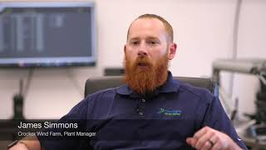
Climate Watch: Video
Courtesy XXXXXX
Lesson 16: Wind Turbine Technicians
Notes:
Note to teacher: This video is a placeholder; the video created for this course will be available in spring 2025. You may skip this slide and the next if you wish.
Day in the Life of a Wind Technician; video from National Grid Renewables (3 minutes)

Slide 7
What stood out to you or surprised you about the daily work of a wind technician?
Wind technicians describe their role as mainly proactive and preventative. Why are those operations critical?
The wind farm in the video is on land. How might working on an offshore wind farm compare to this example?
Climate Watch Discussion
Lesson 16: Wind Turbine Technicians

Slide 8
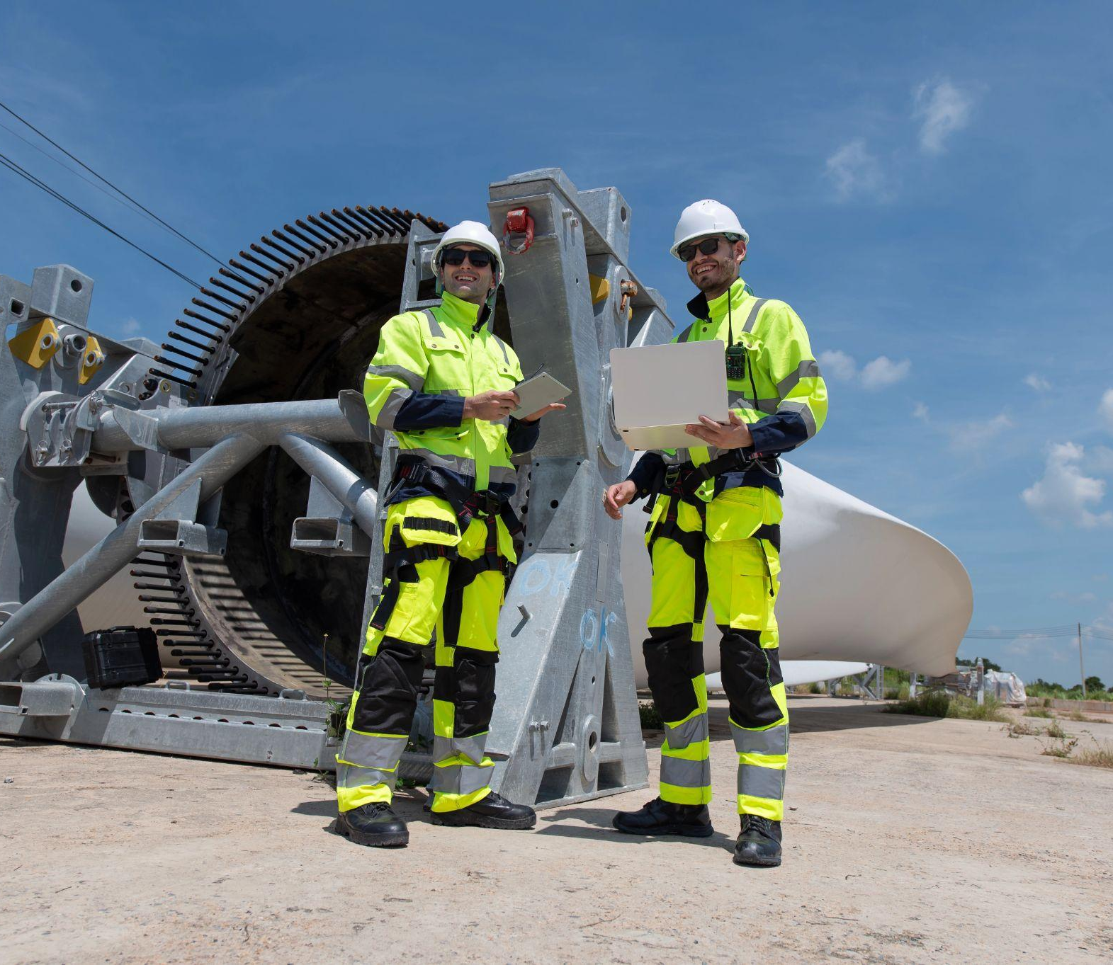
Wind Turbine Technicians
Climb and inspect turbine towers.
Replace mechanical, hydraulic, and electrical components.
Test and analyze turbine performance.
Train new technicians in safety and operations.
Courtesy XXXXXX
Lesson 16: Wind Turbine Technicians
Notes:
Wind turbine technicians perform several tasks essential to the wind energy industry, including maintenance, installation, and troubleshooting.
Technicians ensure turbines operate safely and efficiently, which is critical as we expand wind energy.

Slide 9
Related Roles
Engineers design and test wind turbine components.
Electricians connect wind energy systems to the grid.
Assemblers manufacture and assemble wind turbine parts.
Lesson 16: Wind Turbine Technicians
Notes:
Several other people work closely with wind turbines in addition to wind turbine technicians; some of these people are engineers, electricians, and assemblers.
Each role requires a unique skill set and expertise. These roles are crucial to ensuring that wind turbines and wind farms operate efficiently.

Slide 10
Wind Energy Goals
Generate 5,600 megawatts* from offshore wind by 2027.
Install and maintain at least 120 offshore wind turbines over the next 25–30 years.
* 5,600 megawatts of wind energy will power more than 5 million houses!
Lesson 16: Wind Turbine Technicians
Notes:
Massachusetts has ambitious climate goals, and wind is essential to that plan.
Wind turbine technicians are, therefore, essential to Massachusetts achieving those climate goals.
Demand for these jobs will continue to increase in Massachusetts and the United States.
Massachusetts aims to produce more than 20 percent of US wind-generated power by 2027.

Slide 11
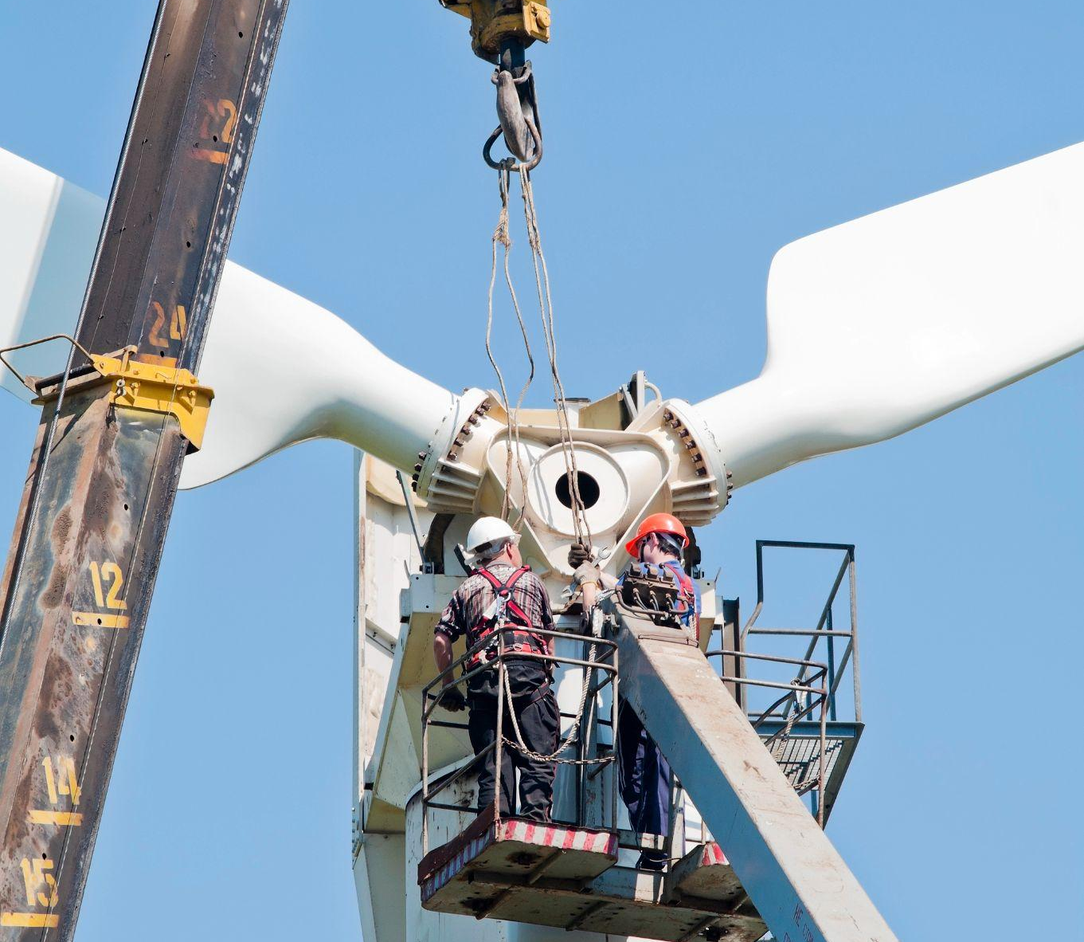
Skills and Knowledge
Physical fitness and endurance
Mechanical, electrical, and hydraulic systems knowledge
Attention to safety and detail
Willingness to work at heights
Lesson 16: Wind Turbine Technicians
Notes:
Many employers are willing to hire fit, dedicated employees and provide on-the-job training or pay for their training.

Slide 12
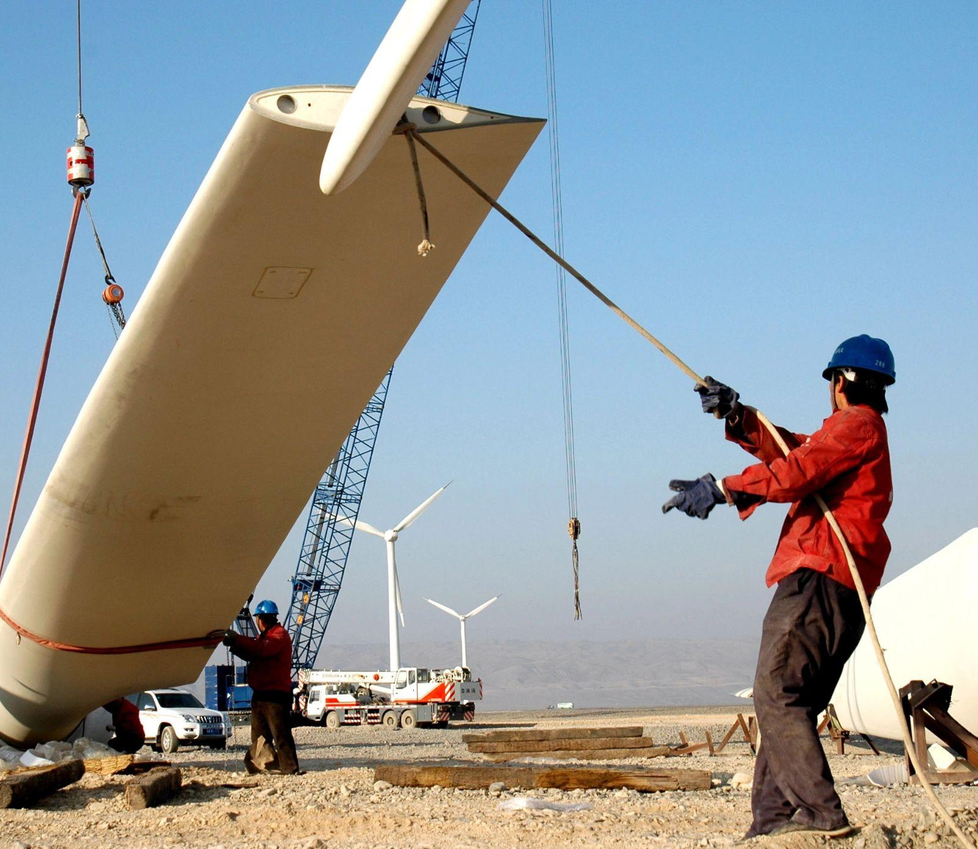
Training Pathways
Apprenticeships
Vocational programs
Lesson 16: Wind Turbine Technicians

Slide 13
Turbine Troubleshoot Challenge
Oh no! One of our turbines isn’t working correctly!
As a group, you must:
Identify the issue.
List the safety considerations.
Identify the necessary skills and expertise to fix the problem.
Present your plan to the class.
Lesson 16: Wind Turbine Technicians
Notes:
Activity Objective: Students will analyze common scenarios wind turbine technicians face. They will identify the problem and outline the safety considerations, skills, and knowledge necessary to diagnose and fix it.
Instructions:
Divide students into four groups and assign each group one of four troubleshooting scenarios from their worksheets:
Scenario 1: Power Drop—the turbine’s power output has suddenly dropped. Possible causes include electrical system issues, a fault in the gearbox, or poor wind conditions.
Scenario 2: Blade Imbalance—A sensor shows that one of the turbine blades is out of balance, which could be due to blade wear, debris accumulation, or a mechanical issue.
Scenario 3: Control System Error—the turbine’s control system has triggered an error code. Possible causes are a software glitch, a wiring issue, or a sensor malfunction.
Scenario 4: Weather-Related Shutdown—the turbine shut down due to extreme weather conditions. The team must inspect it to ensure it’s safe to resume operations.
Working as a team of wind technicians, each group must review details of their scenarios, including the common causes of the issues their turbines are currently experiencing. Then, they must decide how they would diagnose the problem:
What safety considerations are there for this issue? What precautions should be taken? Why?
What skills, knowledge, expertise, and tools would be necessary? Why?
Besides wind turbine technicians, are there other roles they might need to bring in to support them?
After 10–12 minutes, each group will present its scenario to the class along with its plan for troubleshooting the problem. The presentations should last approximately one minute each.

Slide 14
Activity Debrief
What was most challenging about identifying the cause of the problem?
How does the speed of problem-solving contribute to energy reliability?
What role does safety play in a wind turbine technician’s day-to-day work?
Lesson 16: Wind Turbine Technicians
Notes:
Presentations and debrief:
What was most challenging about identifying the cause of the problem?
How does the speed of problem-solving contribute to energy reliability?
What role does safety play in a wind turbine technician’s day-to-day work?
Encourage students to think about the complexity of real-life troubleshooting and how it requires a mix of technical skills and problem-solving.
Reinforce that wind turbine techs play a vital role in ensuring turbines operate at full capacity, directly supporting clean energy goals.
Safety protocols protect techs and ensure work is done efficiently.
Help students connect the dots between reliable turbine operations and Massachusetts’s targets for clean energy production.
Key points to emphasize:
Technicians must prioritize safety, especially in adverse conditions.
Effective teamwork and communication are vital for resolving unexpected issues.
Technicians often face real-time challenges that require quick problem-solving.

Slide 15
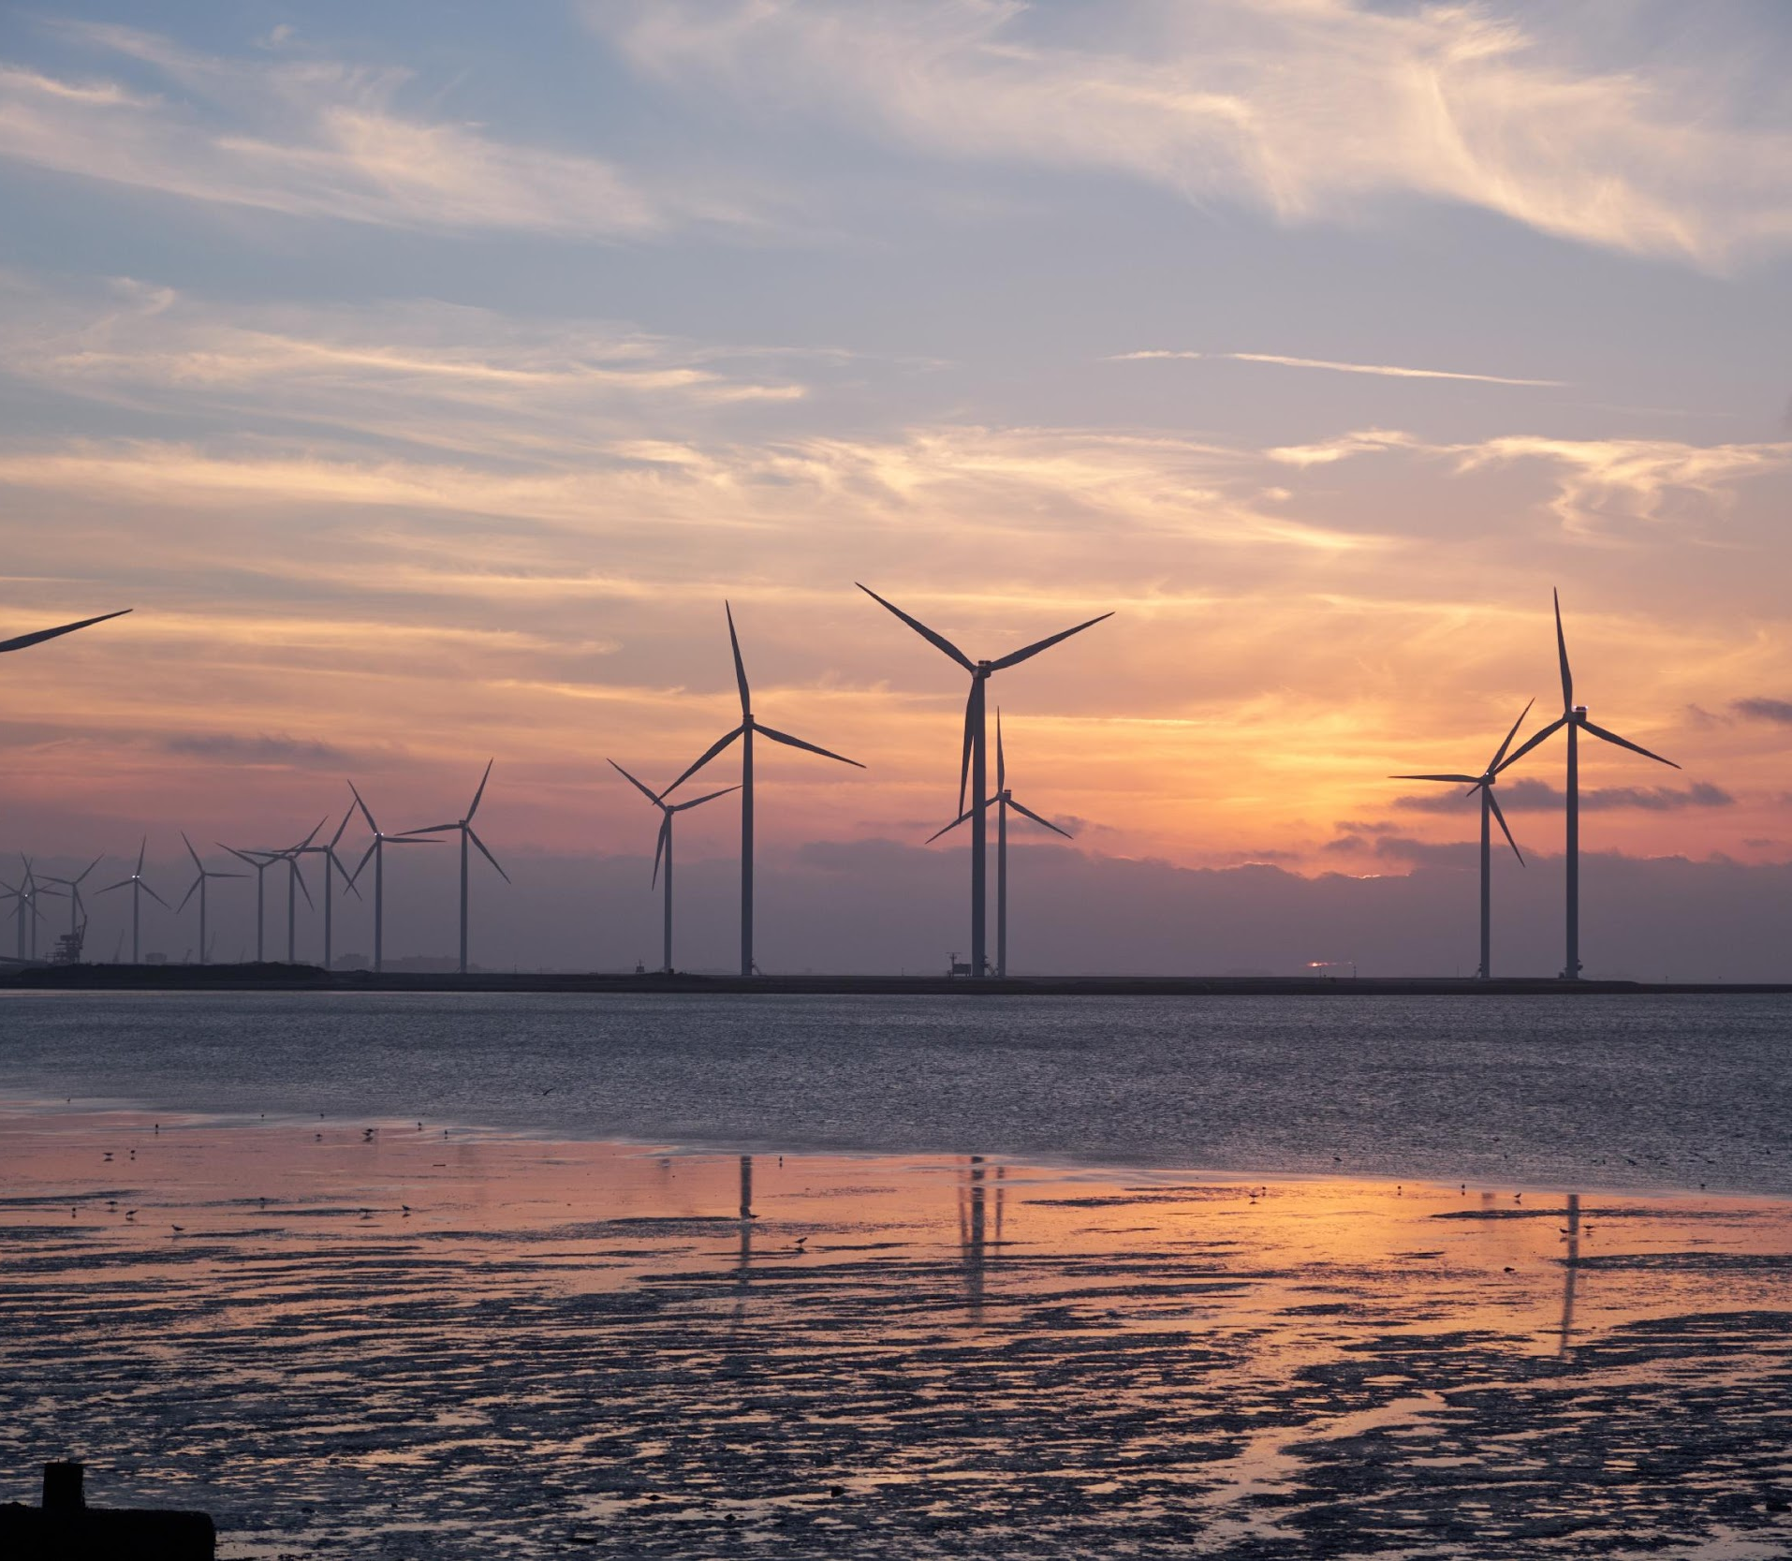
Key Points
Wind turbine technicians are essential to expanding wind energy in Massachusetts.
They need a combination of technical skills and physical endurance.
Demand for technicians is growing due to the state’s clean energy goals.
Lesson 16: Wind Turbine Technicians

Slide 16
Before You Go
What is one aspect of this role that matches your skills or interests?
How does this role contribute to Massachusetts’s status as a climate leader?
Closing Activity
Lesson 16: Wind Turbine Technicians

Slide 17
|
17

